Slide 1
ENVIRONMENT DATA ANALYSIS ACROSS US
About the Data and Requirements of the report:
This data is taken from one of the EDNA challenges where the data was based on 4 parameters or metrics which were Air Toxin Concentration, Asthma, Human Exposure and Heavy Precipitation.
Requirements of the report was to analyse the data on the 4 KPIs and come up with valuable insights and recommendations for the Environmental Experts and Policy Makers.
Dataset Link

Slide 2
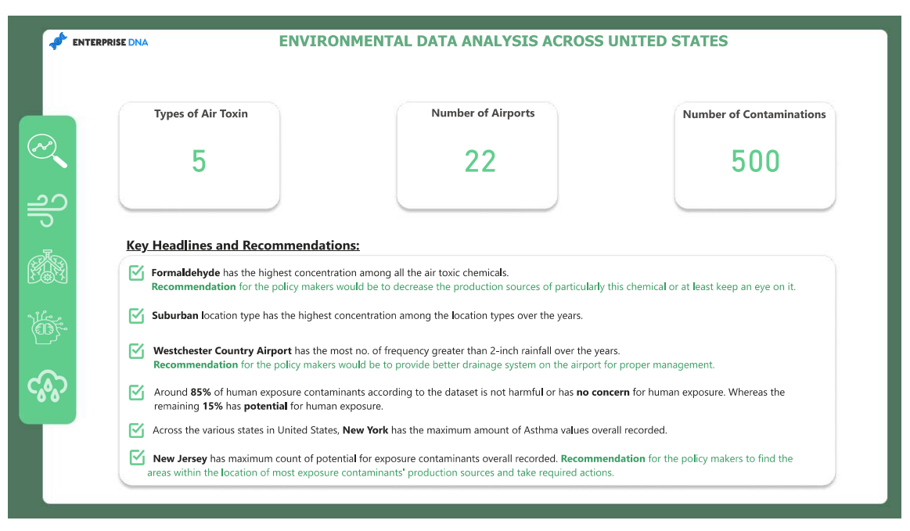
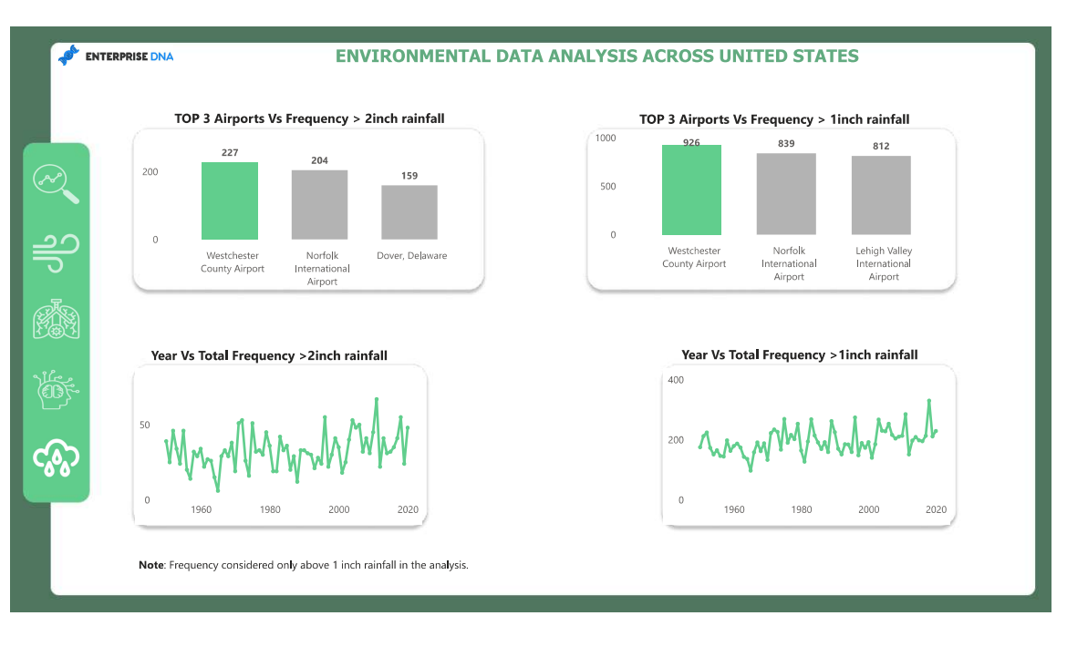
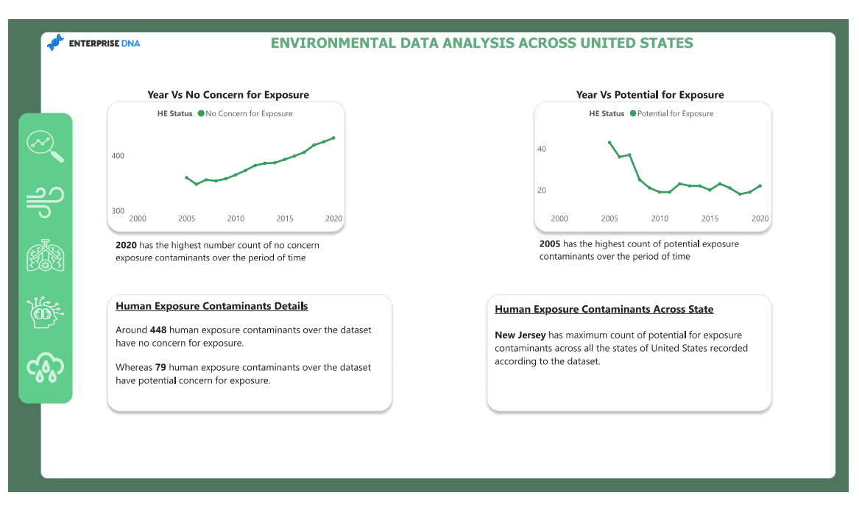
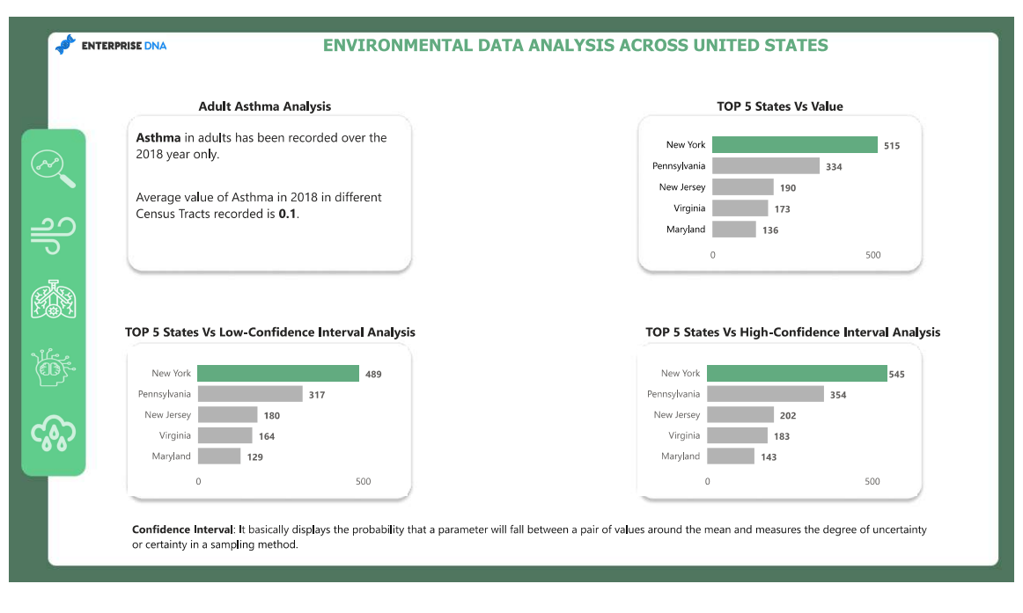
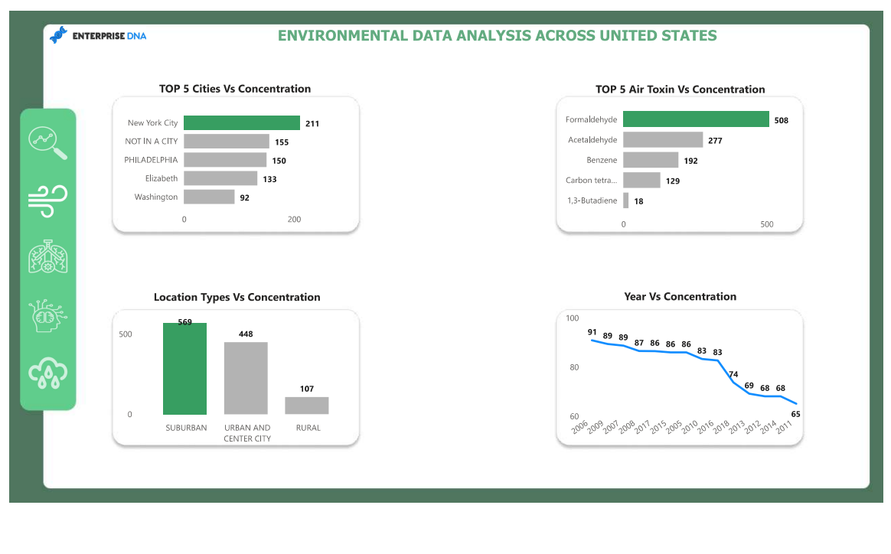
Report based on the KPIs

Slide 3
Key Insights:
Formaldehyde has the highest concentration among all the air toxic chemicals.
Suburban location has the highest concentration among the location types over the years.
Westchester Country Airport has the most no. of frequency greater than 2 inch rainfall over the years.
Around 85% of human exposure contaminants according to the dataset is not harmful or has no concern for human exposure, whereas 15% has potential for human exposure.
Across the US, New York has the maximum amount of Asthma values overall recorded.
New Jersey has maximum count of potential for exposure contaminants overall recorded.

Slide 4
Key Insights:
New York City has the highest air toxin concentration.
New York City has maximum Asthma value overall, highest High-Confidence Interval Analysis & highest Low-Confidence Interval Analysis.
Average value of Asthma over different Census Tracts is 0.1.
Count of potential exposure contaminants recorded decreases over the years whereas count of no concern for exposure contaminants increases over the period of time.
New Jersey has maximum count of potential exposure of contaminants across the United States.
Westchester Country Airport has the highest average frequency over 1 and 2 inch rainfall.

Slide 5
Recommendations for Policy Makers:
Recommendation would be to check and keep an eye on the production sources of Formaldehyde which has the highest concentration.
Recommendation for the policy makers would be to provide better drainage system for the Westchester Country Airport.
As New York has maximum count of potential for exposure contaminants overall recorded, so recommendation would be find the areas within the location of most exposure contaminant production sources and take required actions.

Slide 6
Report Link
Link to Report:

